Slide 1

Contracting and Scoping: how to set a consultancy project up for success?

Slide 2


Why Contracting Conversations Matter
You costed to create a report - now they want
to discuss every step of the way.
You thought they were ready to implement the solution -
now your client still needs to convince the organisation.
You thought the budget was flexible -
their procurement had set fixed rates for the tender.
Contracting isn't just getting a signature on a legal document. That's the easy part. The hard part is the conversation that should precede it.
Key insight: The contract is a conversation about expectations.
If that doesn't happen clearly, problems are just delayed.

Slide 3





What Should Contracting Achieve?
Joint Perspective
Scope & Responsibility
Success Criteria
Agree on what you're actually trying to solve, so that expectations don't collide halfway through.
What are you taking on? What isn't your responsibility? Otherwise, it becomes difficult to push back.
How will you know if this worked? If you can't agree upfront, you don't know what to aim for.
Working Relationship
Practicalities
How will you communicate? Who makes decisions? What access do you need?
Budget, timeline, resources—the practical stuff everyone focuses on. Notice: that's last on the list.
Notes:
Success means outcomes, not deliverables—a report isn't success; improved efficiency or clearer strategy is.

Slide 4
Six Ground Rules for Contracting (cf. Block)
01
02
Fifty-Fifty Responsibility
Freely Entered
Both you and the client share ownership. If you own everything, the client waits passively. If they own everything, why are you there?
All relevant parties should willingly participate.
Contracts imposed on reluctant participants rarely succeed.
03
04
Direct Contact
Only promise what you can deliver
Don't rely on intermediaries. If priorities differ between sponsor and day-to-day contact, you need to know that at the start.
Sounds obvious … but requires a willingness to walk away. Remember that reputation is key.
05
06
Boundaries: Saying No
Write Things Down …
Knowing what you won't do is as important as knowing what you will. Make sure you have space to achieve what matters.
… and adapt as necessary. Contracts are living documents that should guide the engagement (more or less formally).

Slide 5




Understanding Your Stakeholders
Block’s principle about "direct contact with all contract parties" raises a question: who are those parties?
Gatekeepers & Initial Contacts
Main Clients
The people who first hear about you and decide whether you get further.
Who you'll work with day-to-day. They care about whether you're easy to work with and deliver practical value.
Contracting Clients
Sponsoring Clients
Those involved in the purchasing decision, often including procurement. They care about compliance and value for money.
Senior management who own the initiative. They care about strategic outcomes, risk and business impact.
Notes:
Getting an org chart helps - but pay attention to who has real authority versus formal authority; they're not always the same.

Slide 6
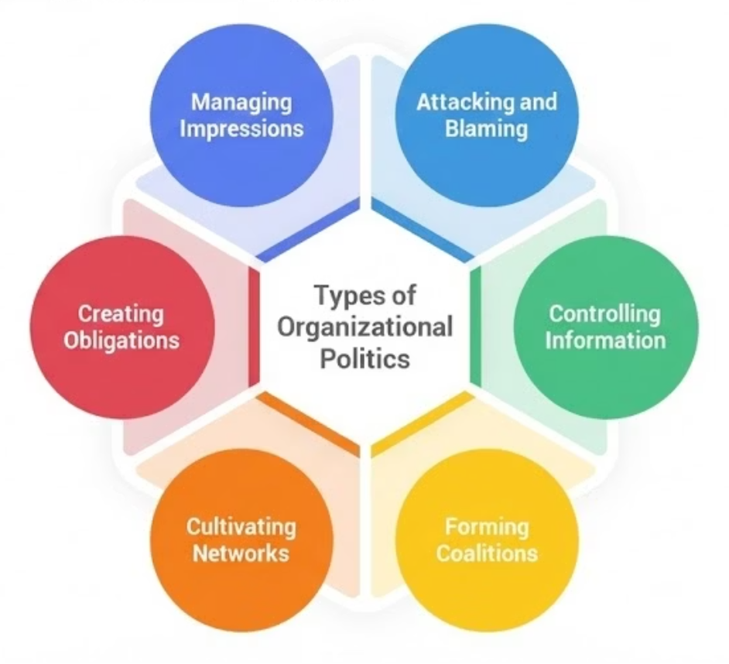

Navigating Organisational Politics
Why political behaviour?
Your Role as Consultant
Change (internal/external)
Awareness isn't about becoming manipulative. It's about knowing where the landmines are – and where there might be a path to change.
Ambiguous goals/targets
Shortage of resources
Some resistance won't be about your analysis at all. It'll be about politics.
And:
Desire for control
Threat to status/power
… and culture more broadly: "the way we do things around here" (Deal & Kennedy, 1982)
Think about a time when you entered an unfamiliar political landscape: a new job, a new team, a new client.
What signals helped you understand the dynamics? What did you miss?
Notes:
Engagement in an organisation where main contact had sued her way back in ...

Slide 7



What's next?
Read this section for some more practical guidance.
Prepare for the live session
Read Block & Sturdy and bring your questions and comments
Read about cognitive biases &
think how they show up in consulting
See you soon.

